Slide 1
Modularization
Clear, Modular and well Documented ML Code

Slide 2
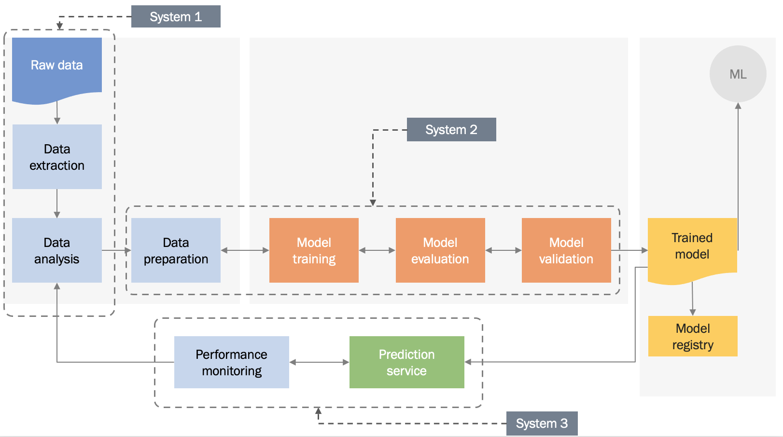
Each ML stage may be an independent system

Slide 3
is the ability to
compose a bunch of microservices together
and the option to use what makes sense for your problem
Composability

Slide 4
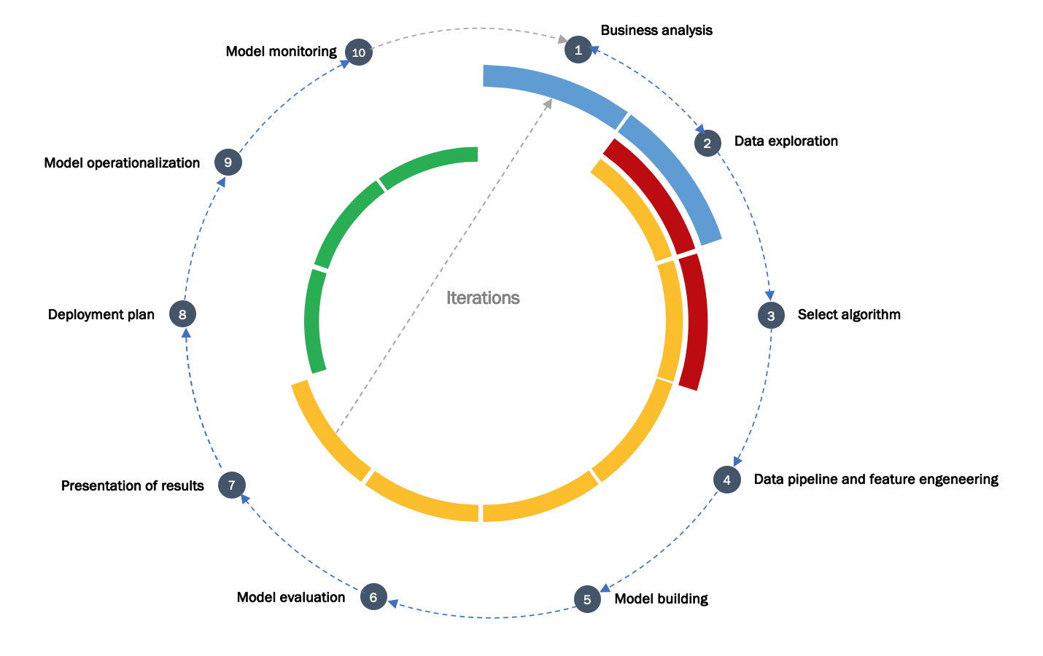
Experimentation
Maintanance
Each stage has it’s own goals and specifics
Development

Slide 5
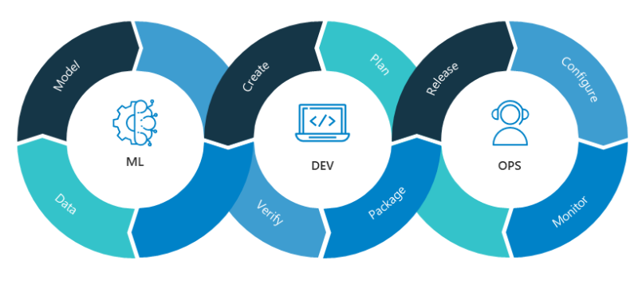


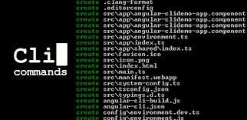
…and is managed by different teams…
Methods,
Tools,
Habits,
Cultures

Slide 6
Experimentation
Training
Cloud

Slide 7
is the ability to
efficiently transfer key microservices between different environments
Portability

Slide 8

Eventually, you will grow-up…

Slide 9
More accelerators (GPU, TPU)
More CPUs
More disk
More networking (transfer)
More skillset (data engineers, data scientists)
More teams
More experiments
Scalability

Slide 10
1
Composability
Your ML framework has to support
2
Portability
3
Scalability

Slide 11



Clean, Modular and Documented Code

Slide 12
Clean Code

Slide 13
For booleans, you can prefix with is_ or has_
to make it clear it is a condition.
You can also use parts of speech to imply types, like using verbs for functions and nouns for variables.
Use meaningful names
Be descriptive
and imply type

Slide 14
You can determine when to make these exceptions based on the audience for your code
If you work with other data scientists, certain variables may be common knowledge
If you work with full stack engineers, it might be necessary to provide more descriptive names in these cases as well
Use meaningful names
Avoid abbreviations and single letters

Slide 15
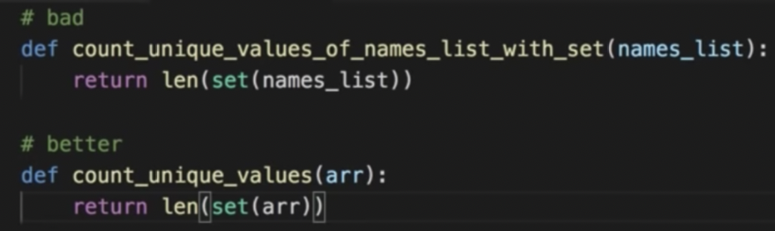
Good function names describe what they do well, without including details about implementation or highly specific uses.
Use meaningful names
Long names aren't the same as descriptive names

Slide 16

Use meaningful names
Ask a fellow programmer…
… to guess the purpose of a function or variable based on its name, without looking at your code

Slide 17
1
Use consistent indentation
Use whitespaces properly
2
Separate sections with blank lines
3
Limit Your lines to 79 characters (PEP 8)

Slide 18
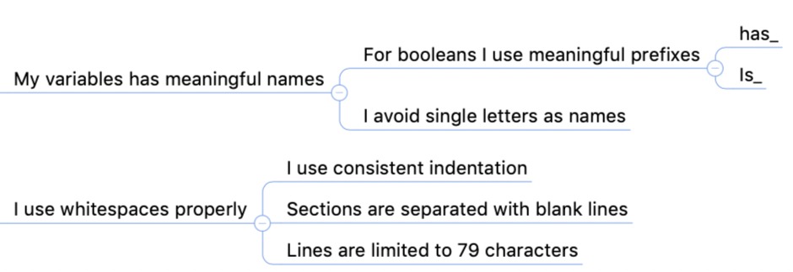
My Checklist

Slide 19
Modular Code

Slide 20
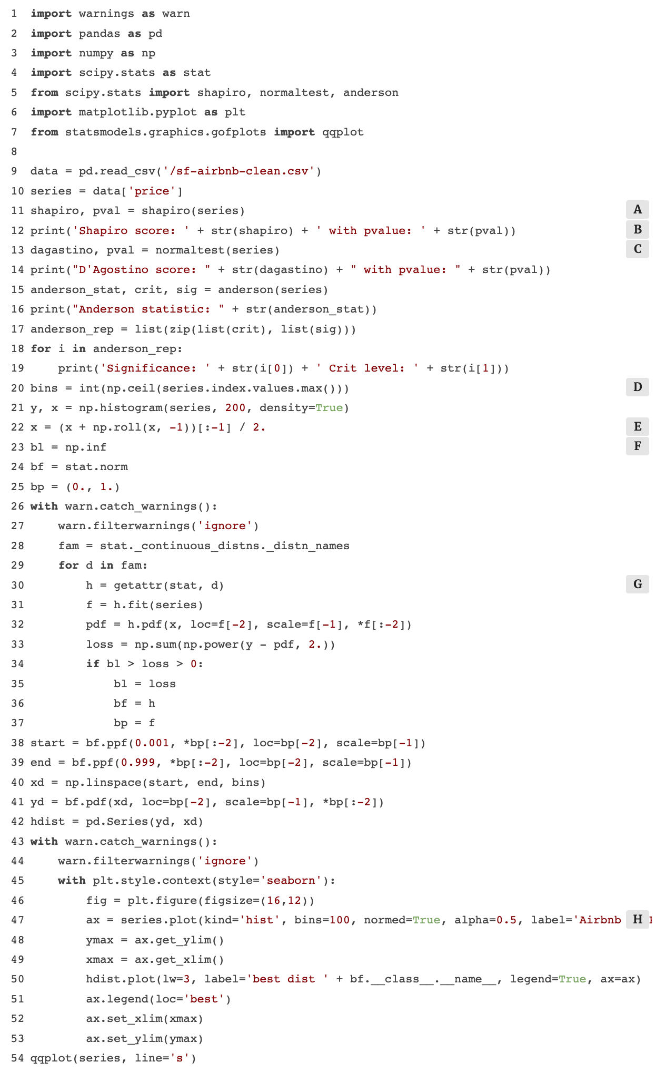
”Typical” DataScience code…
WoT (Wall of Text)

Slide 21
Any fool can write code that a computer can understand. Good programmers write code that humans can understand
Martin Fowler, 2008
WoT code may run perfectly…
… but if we don't understand how, and why, we can't do anything with that

Slide 22

Logically broken up into functions and modules…
functions
modules
def my_function(x, y):
…
my_function(x, y)
module_name.py
my_function(a, b)
import module_name
import module_name

Slide 23
… is more organized, efficient and reusable
functions
modules
def my_function(x, y):
…
my_function(x, y)
module_name.py
my_function(a, b)
import module_name
import module_name

Slide 24
Module = file
functions
modules
def my_function(x, y):
…
Modules allow code to be reused by encapsulating them into files that can be imported into other files.
my_function(x, y)
module_name.py
my_function(a, b)
import module_name
import module_name

Slide 25
Monolitihc
Complex, large functions or methods
Modularized
Functionalities logically grouped into smaller function or methods
How code is structured?
Strong encapsulation
Naming conventions easy to understand for humans
Function, module and class docstrings
Confusing variable names
Commented-out code
Dead code
How code is written?
Serial
Single-machine
High complexity
Asynchronous
Distributed
As low as possible complexity
How efficiently it runs?
Nested logic (code buries in for or while loops)
No logical boundaries
How easy it is to troubleshoot?
Decoupled functionality allows for testing per logical groups
How much information
is retained about each run?
Retention of logs for each run
Metric and artifact storage
print statements
Little/no metrics or stats recorded
No artifact storage

Slide 26
Modularization allows you to reuse parts of your code
Generalize and consolidate repeated code in functions or loops.
DRY
Don’t repeat Yourself

Slide 27
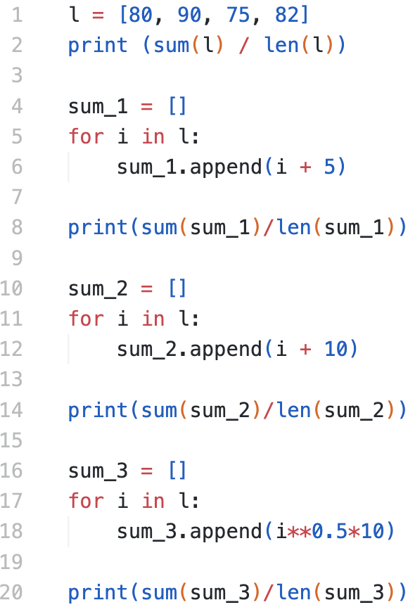
DRY
bad

Slide 28
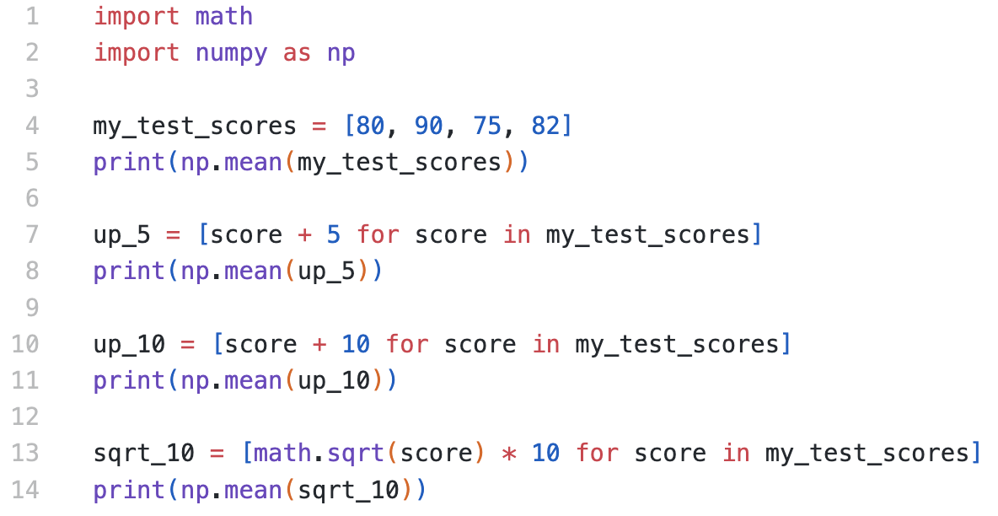
DRY
little better

Slide 29
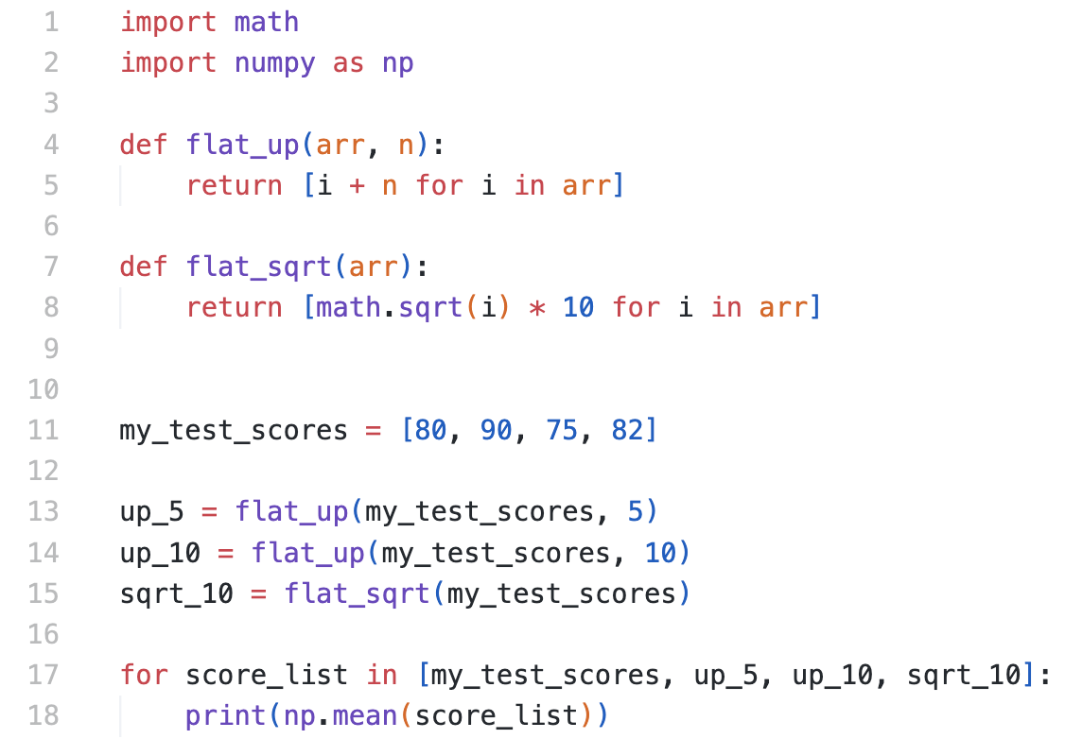
DRY
better

Slide 30
Abstract out logic to improve readability
Abstracting out code into a function makes it less repetitive and improves readability with descriptive function names

Slide 31
Abstract out logic to improve readability
But use your judgement: it is possible to over-engineer this and have way too many modules

Slide 32
If you have broken up your code into an unnecessary amount of functions and modules, you'll have to jump around everywhere if you want to view the implementation details for something that may be too small to be worth it
Minimize the number of entities
Functions, classes, modules, etc.
Creating moreodules doesn't necessarily result in effective modularization.

Slide 33
1 function
1 thing
Functions should do one thing
Generally, if there's an "and" in your function name, consider refactoring.

Slide 34
< 3 args
Fewer than 3 arguments per function
This is not a hard rule and there are times when it is more appropriate to use many parameters. But in many cases, it's more effective to use fewer arguments

Slide 35
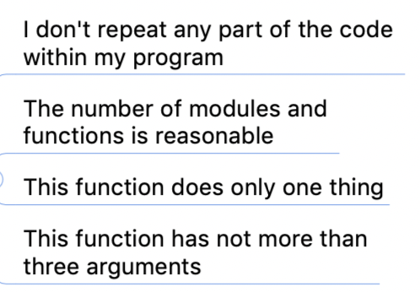
My Checklist

Slide 36
Well Documented Code

Slide 37
Inline comments
# inline comment
Explain parts of Your code
Document its major steps
Describe history, motivation, limitations, TODOs…

Slide 38
```
Some module docstring
```
``` A function docstring ```
Docstrings
Explain the functionality of any function or module in Your code
Are surrounded by triple quotes
# inline comment

Slide 39
```
Some module docstring
```
``` A function docstring ```
Docstrings
One-line docstring
# inline comment

Slide 40
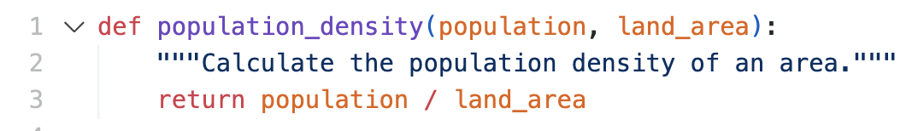
Docstrings
One-line docstring

Slide 41
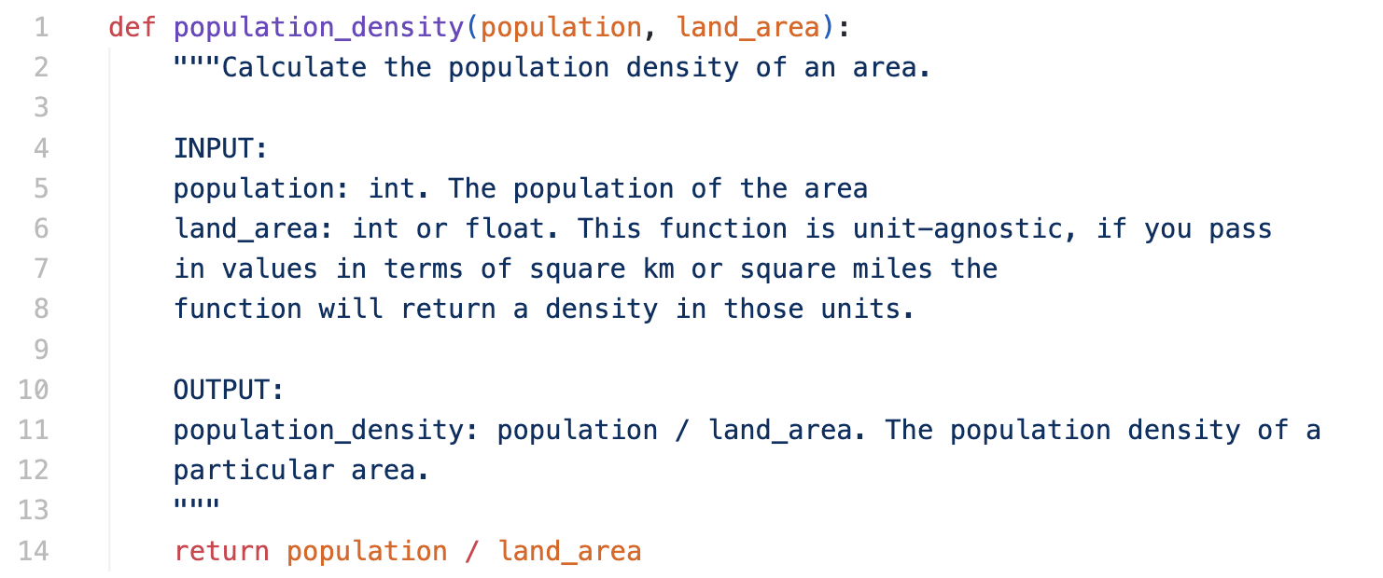
Docstrings
Multi-line docstring

Slide 42
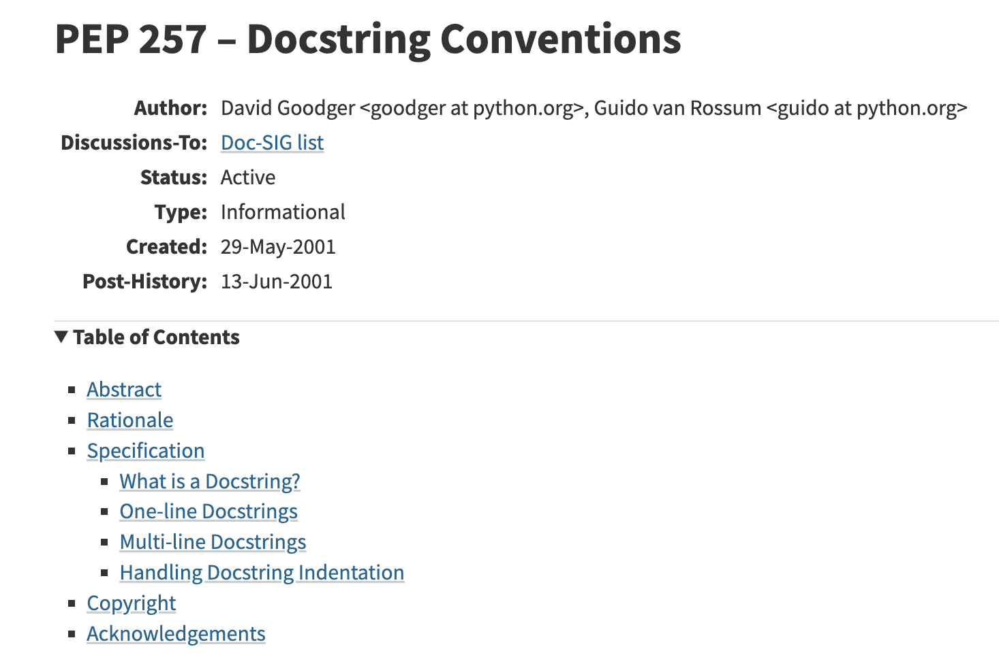
Docstrings
Follow PEP 257

Slide 43
Project documentation
Why and how the code is relevant to the user?
What it does?
Dependencies
How to use it?
README.md

Slide 44

Project documentation
Follow the course on writing good README.md

Slide 45
Useful tools

Slide 46
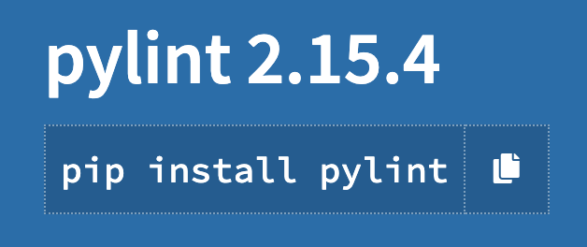
Pylint
Checks PEP-8 compliance

Slide 47
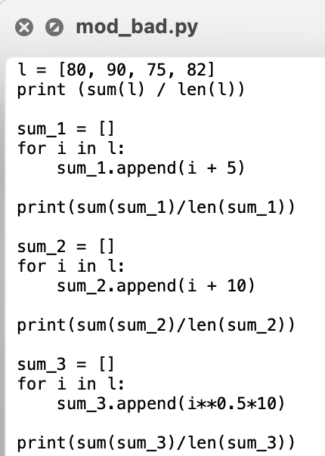
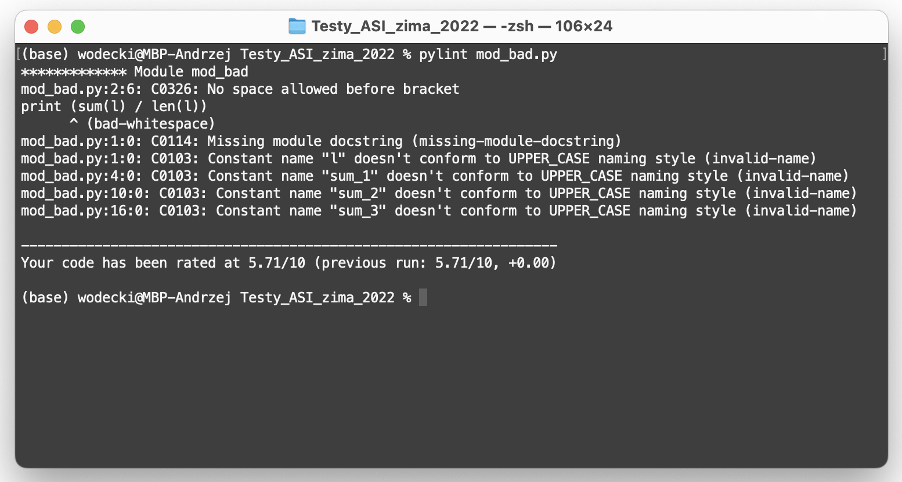
Pylint
Provides feedback on updates to your code, as well as a score out of 10 that can help you understand which improvements are most important.

Slide 48
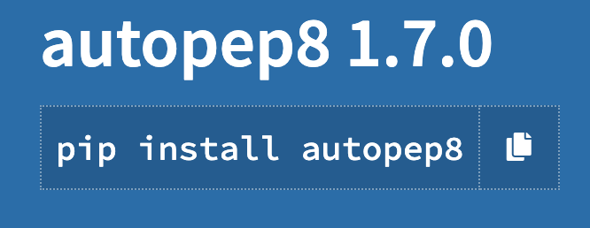
Autopep8
Attempts to automatically clean up your code.

Slide 49
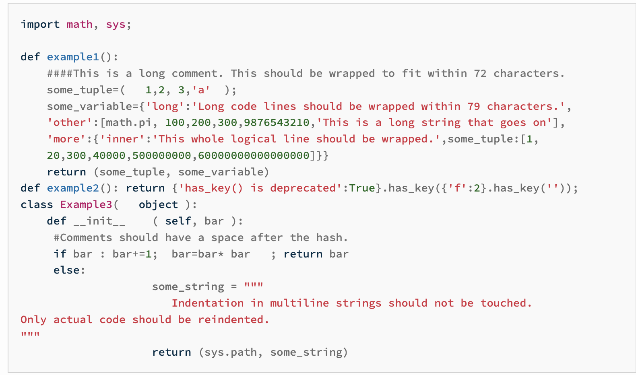
Autopep8
before
autopep8 --in-place --aggressive my_script.py

Slide 50
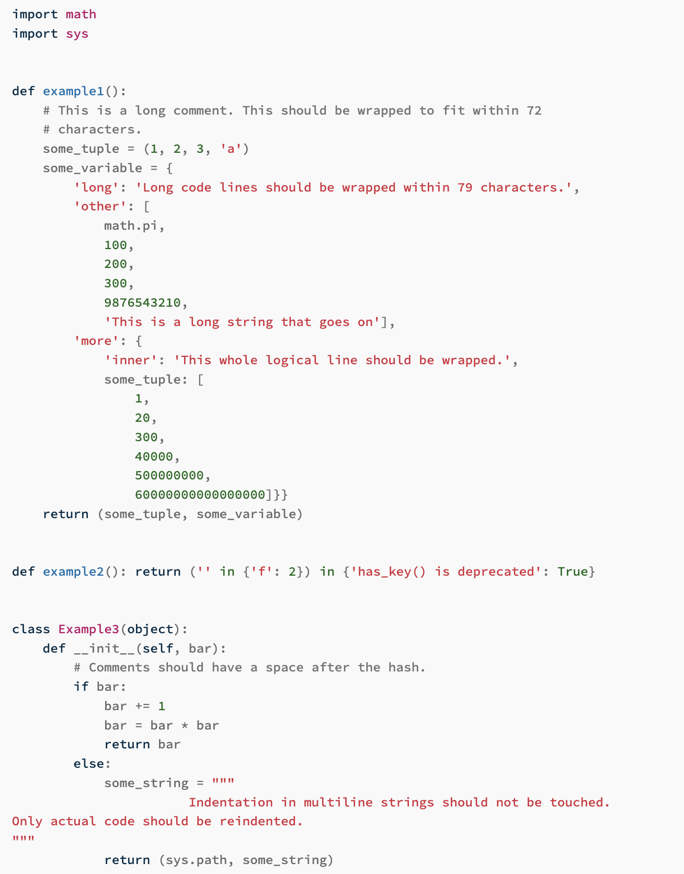
Autopep8
after

Slide 51
Example 1. Simple regression

Slide 52
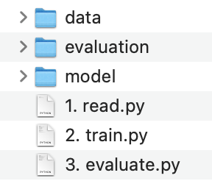
Simple Regression
Train a toy LinearRegression Model

Slide 53
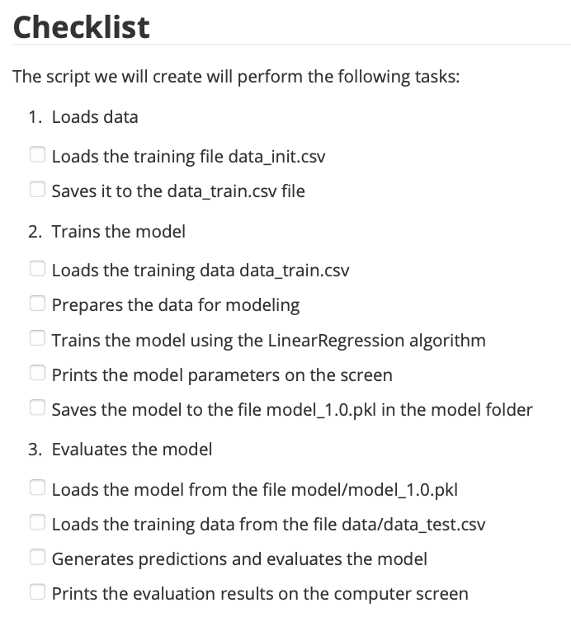
Start with a precise PBS
> checklist

Slide 54
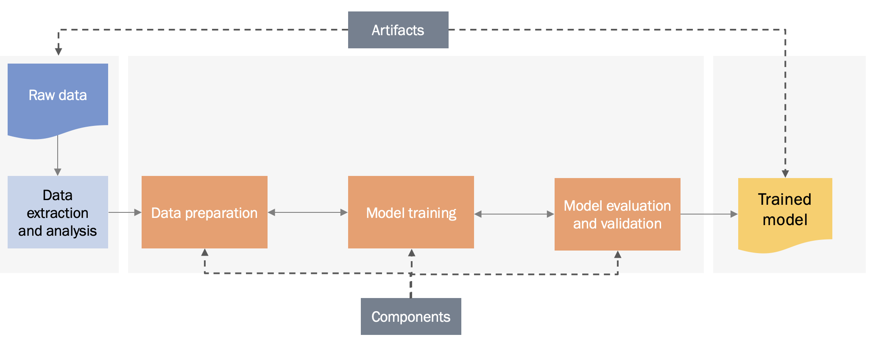
Pipeline = components + artifacts
Decompose a flow using artefacts, components, and decisions

Slide 55
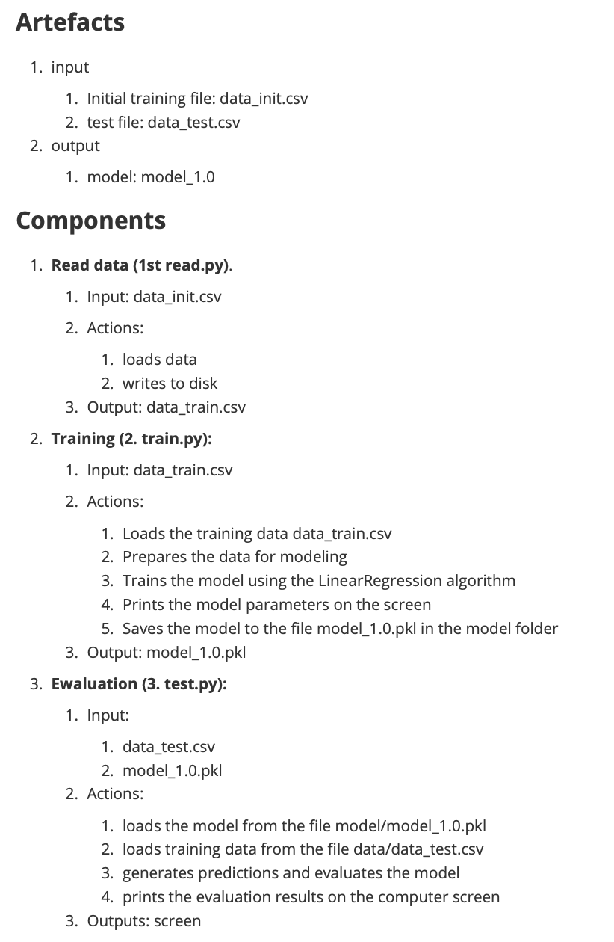
Pipeline = components + artifacts
Decompose a flow using artefacts, components, and decisions

Slide 56
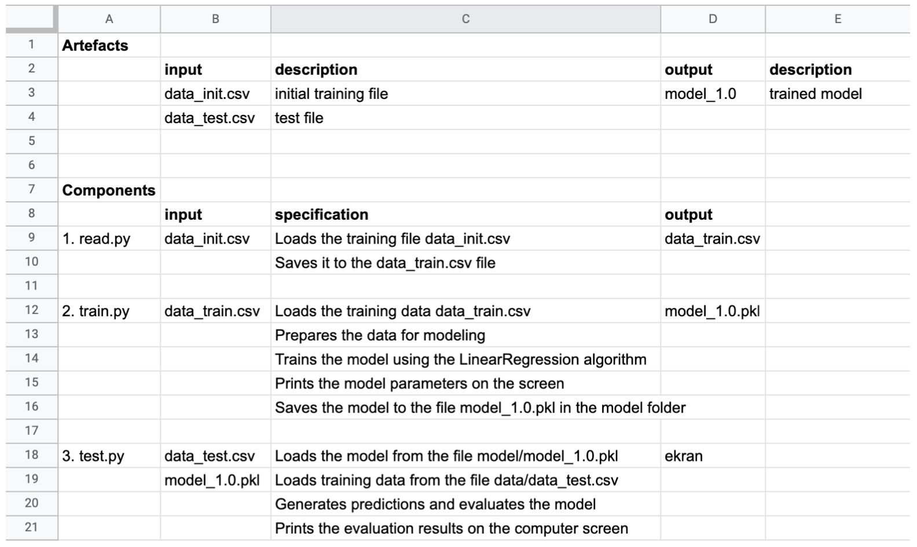
Create a simple architecture in spreadsheet
Consider using simple spreadsheet like this

Slide 57
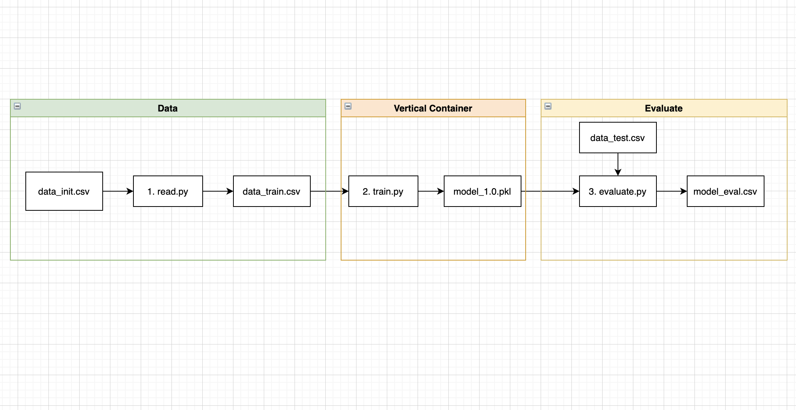
Visualize
Use Draw.io to visualize the pipeline

Slide 58
Result

Slide 59
Example 2. Customer analytics

Slide 60
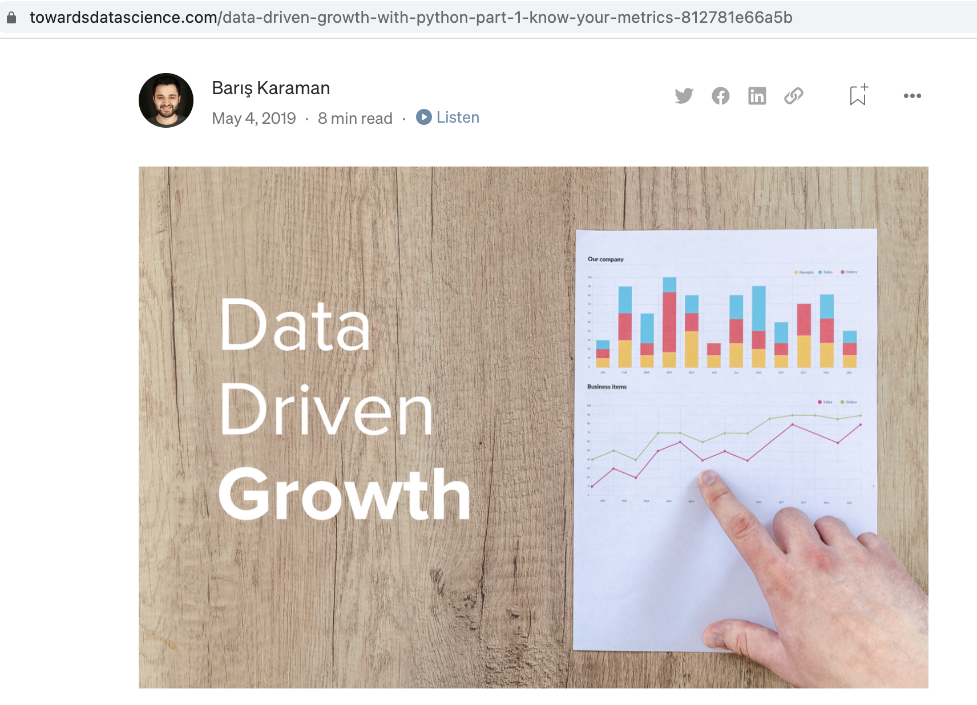
Customer segmentation

Slide 61
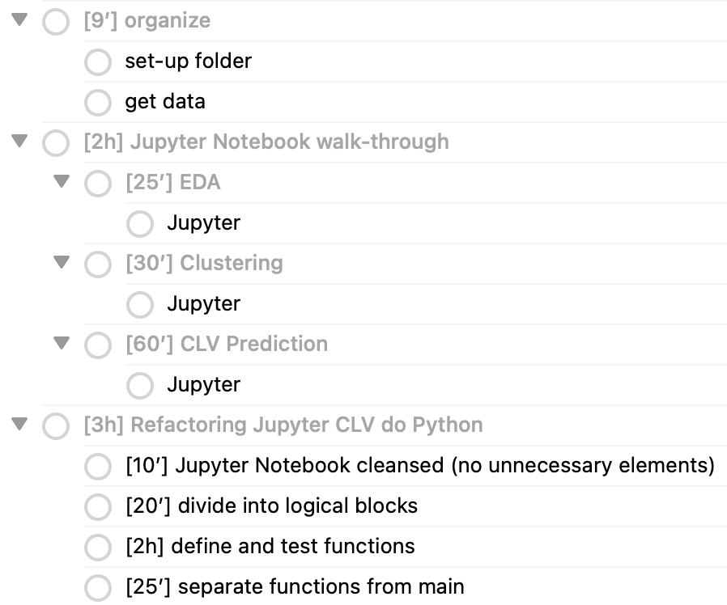
My (real) checklist
Notes:
- [9’] organize @parallel(true) @autodone(false)
- set-up folder @parallel(true) @autodone(false)
- get data @parallel(true) @autodone(false)
- [2h] Jupyter Notebook walk-through @parallel(true) @autodone(false)
- [25’] EDA @parallel(true) @autodone(false)
- Jupyter @parallel(true) @autodone(false)
- [30’] Clustering @parallel(true) @autodone(false)
start: 08.04 . End: 08.42, ale z 12 minutową przerwą
- Jupyter @parallel(true) @autodone(false)
- [60’] CLV Prediction @parallel(true) @autodone(false)
start: 08.50
- Jupyter @parallel(true) @autodone(false)
- [3h] Refactoring Jupyter CLV do Python @parallel(true) @autodone(false)
- [10’] Jupyter Notebook cleansed (no unnecessary elements) @parallel(true) @autodone(false)
- [20’] divide into logical blocks @parallel(true) @autodone(false)
start: 11.54
- [2h] define and test functions @parallel(true) @autodone(false)
- [25’] separate functions from main @parallel(true) @autodone(false)

Slide 62
Example 3. HighRev classifier (DKU)

Slide 63
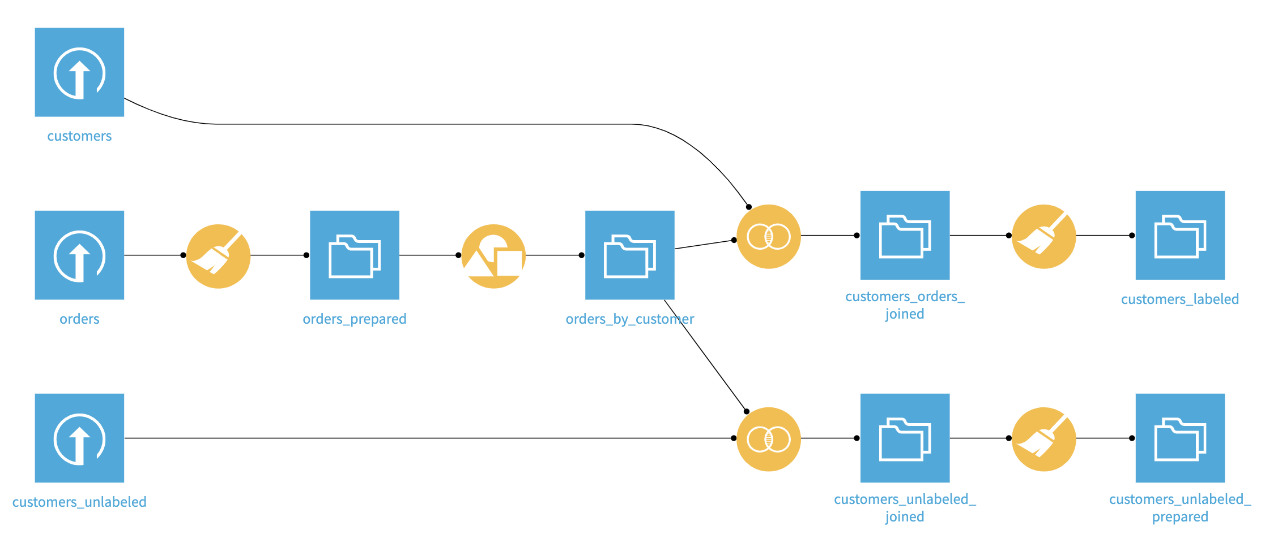
HighRev
Predict HighRevenue Customers - Dataiku

Slide 64
Example 4. Tweet classifier (disaster response)

Slide 65
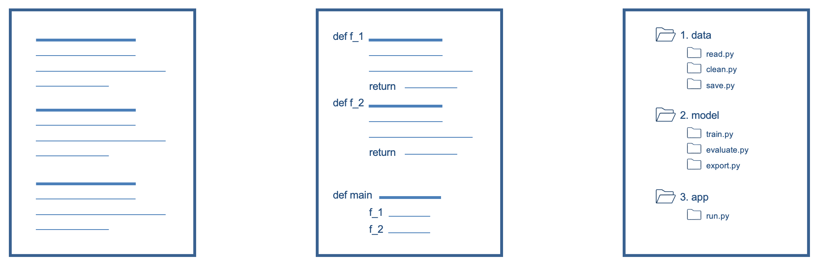
Disaster response
Use NLP models to classify the content of tweets/SMSs for specific threats

